Slide 1
Circuits
Lecture 3: Mesh Analysis
李宏毅 Hung-yi Lee

Slide 2
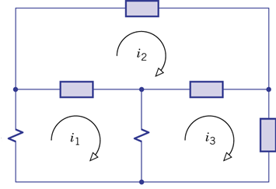
Introduction
Mesh 1
Mesh 2
Mesh 3
Node analysis:
Mesh analysis:
Current + Voltage
Voltage
Potential
Current + Voltage
Current
Mesh Current
Mesh: closed current path that contains no closed paths within it (Textbook, P149)
Meshes are “holes” in the circuits.

Slide 3
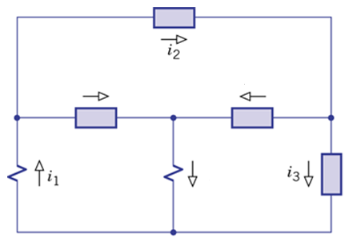
Mesh analysis
Target of Mesh analysis is to find the mesh currents.
Notes:
Mesh current are independent

Slide 4
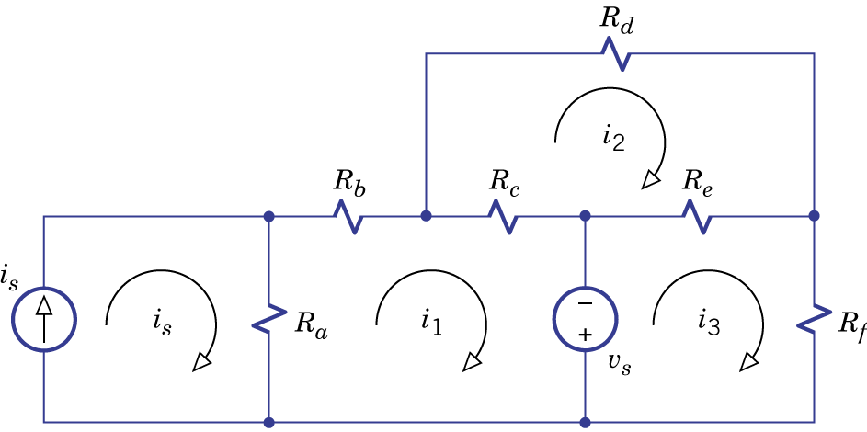
Mesh analysis
Consider KCL:
Represent i_{b}, i_{c} and i_{d} by mesh current
KCL is already fulfilled

Slide 5
Mesh analysis
Consider KVL:
Represent v_{a}, v_{b} and v_{c} by mesh current

Slide 6
Mesh analysis
For mesh 1: R_{a}(i₁-i_{s}) + R_{b}i₁ + R_{c}(i₁-i₂) =v_{s}
For mesh 2: R_{c}(i₂-i₁) + R_{d}i₂ + R_{e}(i₂-i₃) = 0
For mesh 3: R_{e}(i₃-i₂) + R_{f}i₃ + v_{s} = 0
Can we always represent voltage by mesh currents?

Slide 7
Mesh analysis – 3 cases
Represent the voltage of (1) voltage sources, (2) resistor, and (3) current sources by mesh current

Slide 8
Mesh analysis - current sources
1. Current sources on the perimeter of the circuit

Slide 9
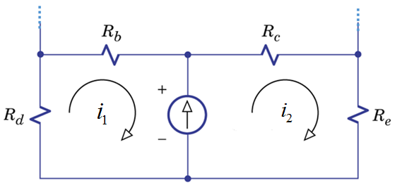
Mesh analysis - current sources
2. Interior current sources
Method 1:
Consider v_{s} as unknown variables
Represent the voltages v_{d}, v_{b}, v_{c} and v_{e} …. (except v_{s}) by mesh current
Solve mesh currents and v_{s}
……
One more equation:

Slide 10
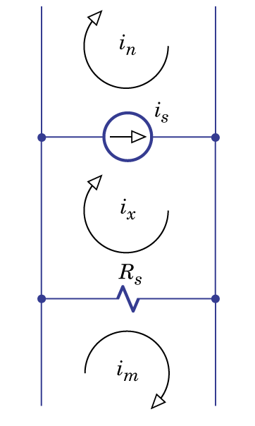
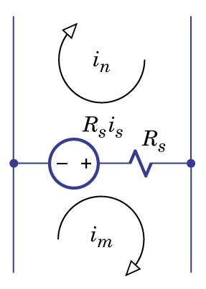
Mesh analysis - current sources
2. Interior current sources
Method 2:
when the current source is parallel with a resistor
Textbook:
Chapter 2.5

Slide 11
Mesh analysis - current sources
2. Interior current sources
Method 2:
when the current source is parallel with a resistor
Another point of view:
The voltage of is i_{s} equal to R_{s}.

Slide 12
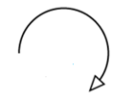
Mesh analysis - current sources
2. Interior current sources
Method 3:
supermesh

Slide 13
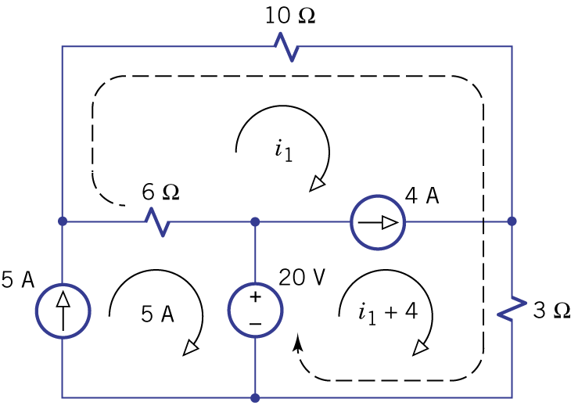
Example 4.9
6(i₁-5) + 10i₁ + 3(i₁+4) = 20
→i₁=2A

Slide 14
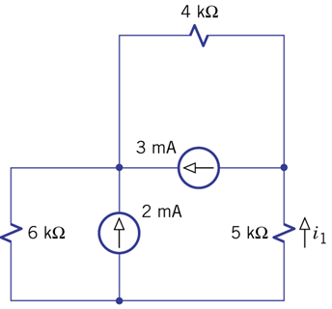
Exercise 4.11
Special case:
current sources are parallel with resistors

Slide 15
Exercise 4.11

Slide 16
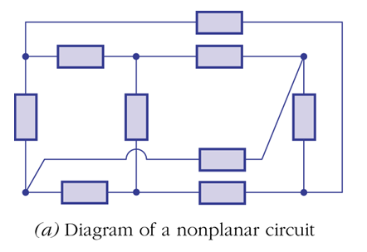
Non-planar Circuit
Mesh analysis cannot be applied on non-planar circuit
Cannot transform this circuit into planar circuit

Slide 17
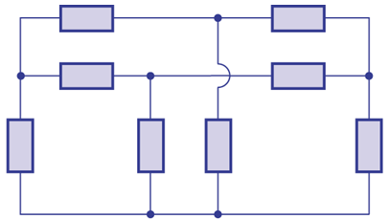
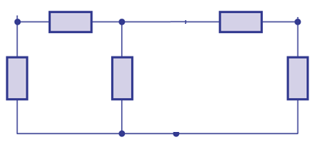

Non-planar Circuit
Some non-planar circuits can be transformed into planar circuit
A
B
C
C
A
B

Slide 18
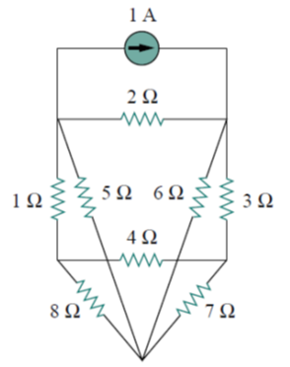
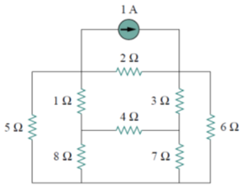
Non-planar Circuit
Some non-planar circuits can be transformed into planar circuit

Slide 19
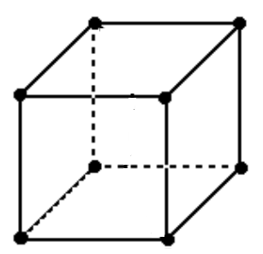
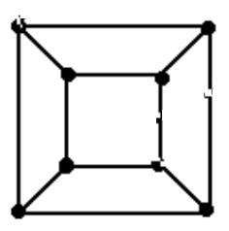
Non-planar Circuit
Why mesh analysis cannot be applied on non-planar circuit?
6 meshes?
5 meshes

Slide 20

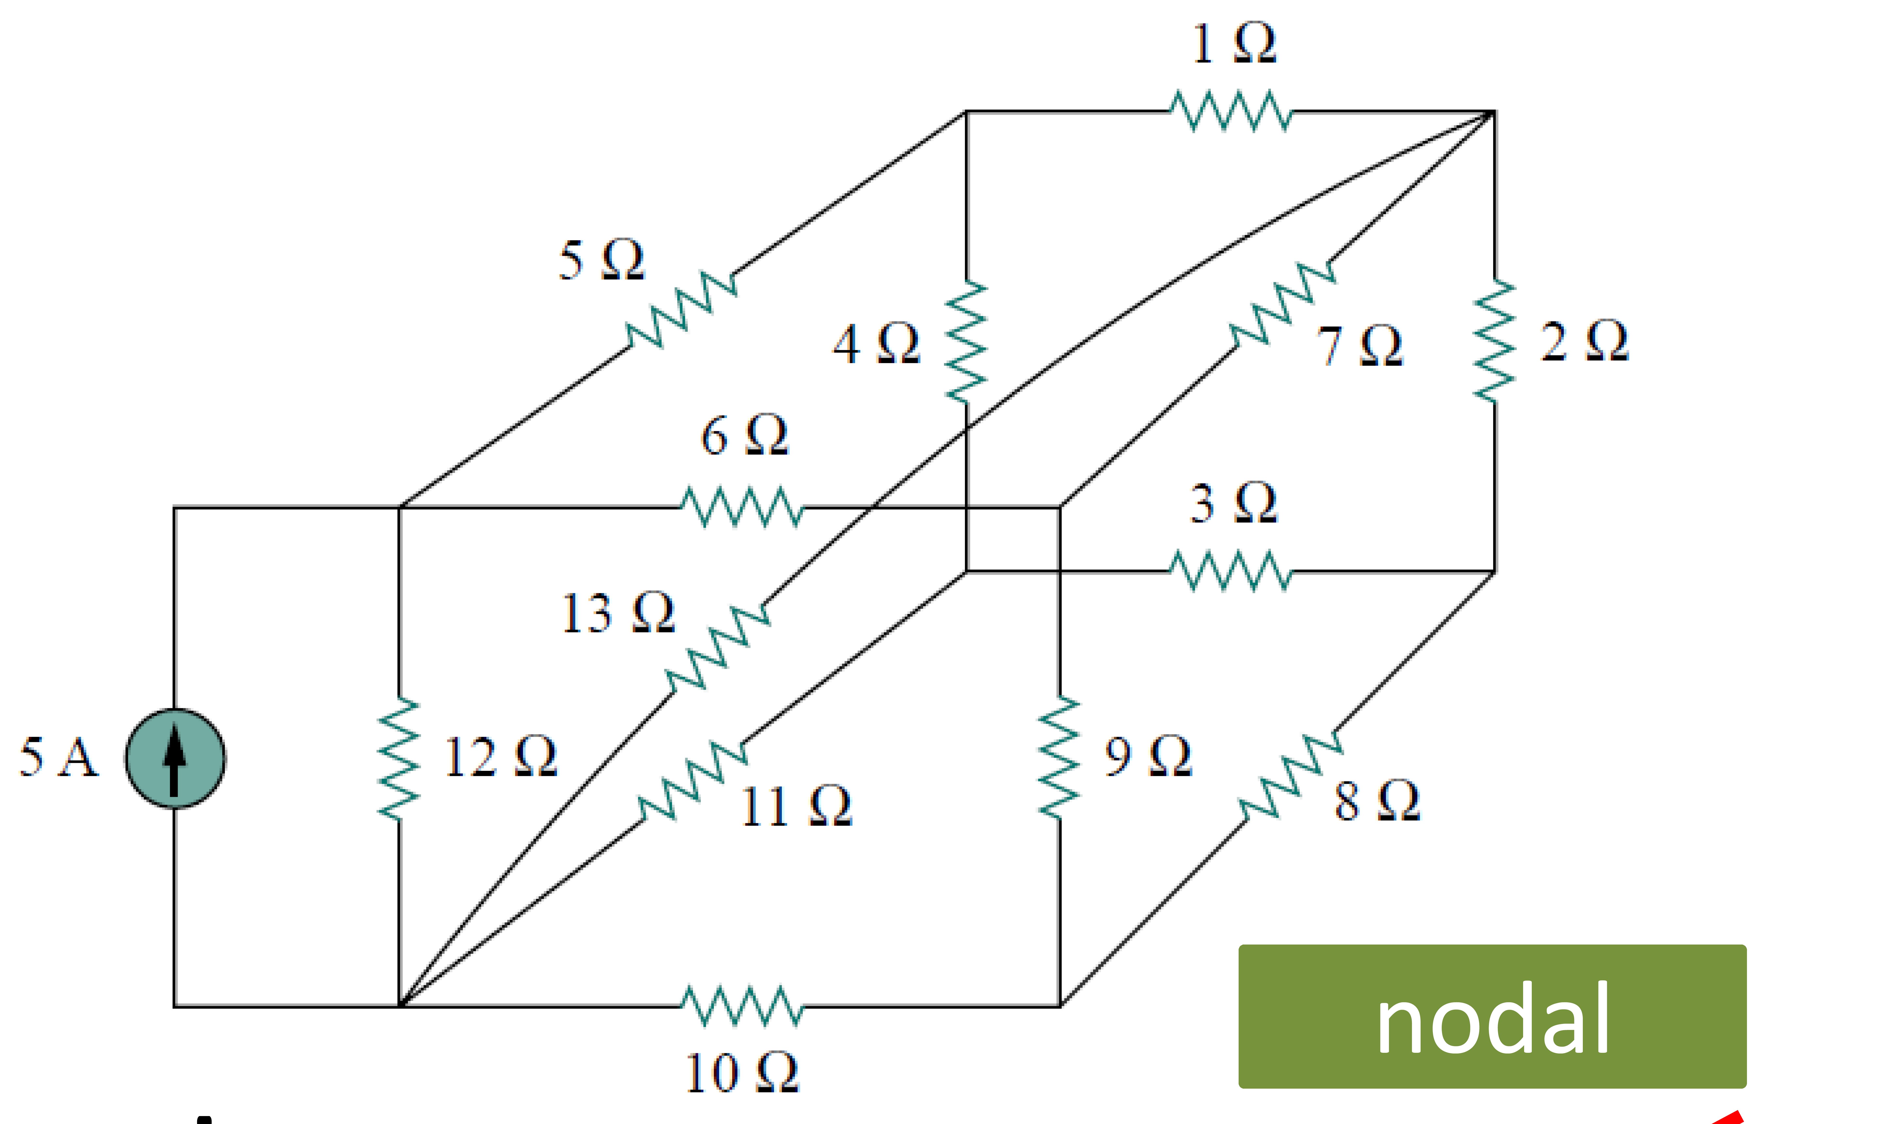
Node v.s. Mesh

Slide 21
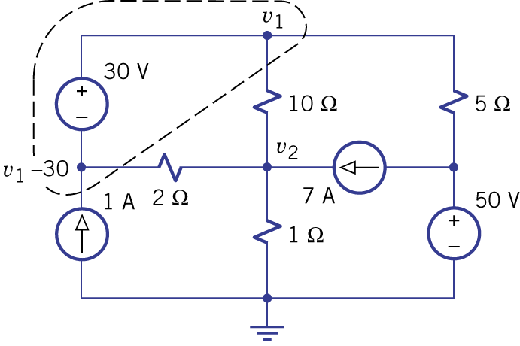
Node v.s. Mesh
What is the final target?
  Node analysis is not suitable for current
  Mesh analysis is not suitable for voltage
i
v
+
-
If node analysis is used, it is tedious to find i
If mesh analysis is used, it is tedious to find v

Slide 22
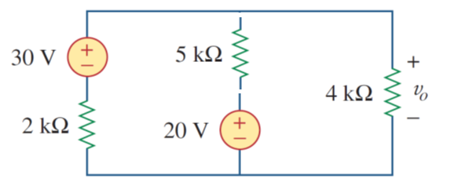
Node v.s. Mesh
Number of Equation: Number of Nodes v.s. Number of Meshes
Number of Voltage sources v.s. Number of Current sources
Use both to check your results

Slide 23
Homework
4.38
4.42

Slide 24
Thank you!

Slide 25
Answer
4.38
  V1=24, v2=-16, v3=20
4.42
  I1=3, i2=3.5, i3=3, v1=0, v2=15

Slide 26
Acknowledgement
  感謝 林楷恩 (b02)
  糾正錯誤的作業答案

